Slide 1
P&C, Life & Specialty Insurance
AI orchestration for property & casualty, life, & specialty carriers — powered by the #1 iPaaS
Notes:
Slide Structure:
Slide 1: Title + Hook
Title: "Accelerating Banking Operations with AI & Automation"
Subtitle: [Prospect Bank Name] + Workato
Visual: Banking imagery (not stock handshake clichés)
Script: "Thanks for the time today. I want to share how leading banks are using automation to transform loan processing, compliance, and customer experience..."
Slide 2: The Challenge (Industry-Specific)
Headline: "Banks Are Caught Between Growth Pressure and Operational Complexity"
Content (3 visual stats):
📉 "Customer expectations: Same-day loan decisions"
⚠️ "Reality: 7-14 day processing times, 23% abandonment"
💰 "Impact: $4.2M in lost revenue annually for mid-size banks"
Visual: Icons + brief stats (not bullet points)
Script: "What we're hearing from banks like yours: customers expect instant decisions, but manual processes across Salesforce, your LOS, and core banking create bottlenecks..."
Slide 3: The Workato Approach (Solution Framework)
Headline: "Orchestrate Data, Systems & AI Across Your Banking Operations"
Content (3 capability pillars with icons):
🔗 Connect Everything: 1200+ connectors (Salesforce, nCino, Temenos, SAGE, Guidewire)
🤖 Add Intelligence: AI agents for underwriting, fraud checks, compliance
⚡ Empower Teams: Business users build workflows, not just IT
Visual: Simple architecture diagram showing systems flowing through Workato
Script: "Workato sits in the middle, orchestrating data between your CRM, loan origination, core banking, and compliance systems. Your business teams can build and modify these workflows without waiting on IT..."
Slide 4: Proof (Customer Success Snapshot)
Headline: "[Similar Bank/Credit Union] Achieved These Results in 6 Months"
Content (Before/After metrics):
Loan processing: 7 days → 4 hours ⚡
Cost per loan: $450 → $180 💰
Compliance violations: 12 → 0 ✅
FTE redeployed: 15 employees to customer service 👥
Visual: Customer logo + headshot + quote (if approved)
Quote: "Workato gave us the agility to launch new products without rip-and-replace." - VP Digital Banking
Script: "Here's a credit union similar to you in size and tech stack. They were struggling with the same loan processing bottleneck. After implementing Workato..."
Slide 5: Next Steps (Clear CTA)
Headline: "Let's Explore What's Possible for [Prospect Name]"
Content:
✓ Discovery Workshop (2 hours): Map your loan origination process
✓ Value Assessment (1 week): Quantify your automation opportunity
✓ Pilot Use Case (30 days): Prove ROI with one workflow
Visual: Simple timeline graphic
CTA: "Can we schedule a 2-hour workshop with your lending and IT teams?"
Script: "I'd love to do a deeper dive on your specific environment. We typically start with a discovery workshop where we map your current loan process, identify automation opportunities, and build a business case..."
Customization Zones for Partners/Sellers:
Slide 1: Add partner logo (if GSI co-sell)
Slide 2: Swap industry stats (use different challenge if prospect cares more about compliance than loans)
Slide 4: Change customer proof to closest match (community bank vs. regional bank vs. credit union)

Slide 2


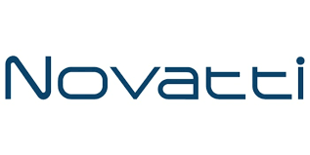

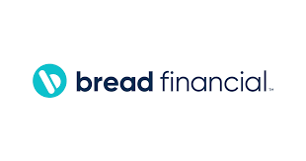

Accounts opened.
Loans approved.
Customers answered.
Work done!
Notes:
Top vertical segment messaging

Slide 3
Claims cost. Compliance pressure. Distribution disruption.
Enterprise Agility: 68% of insurance CIOs cite legacy system integration as the #1 barrier to digital transformation (KPMG). Guidewire, Duck Creek, and legacy COBOL cores weren’t designed to work with Salesforce, Snowflake, or an AI claims agent. Carriers running PAS migration programs need orchestration that connects old and new in parallel — not a two-year custom build. Efficiency & OrCA: Swiss Re: every 1% improvement in combined ratio = $650M impact for a top-10 P&C carrier. Deloitte: straight-through processing rates for auto claims expected to reach 50%+ by 2026. IDP Genie on AWS Bedrock + Anthropic Claude extracts photos, repair estimates, and medical bills automatically — no adjuster touchpoint for routine claims. OrCA autoscales elastically during CAT events without infrastructure provisioning. Risk Reduction: Every AI claim decision needs a defensible audit trail for state regulatory examiners and E&O defense. HIPAA BAA available for carriers handling medical data. SOC 2 Type II certified. Zero Downtime Upgrades — no maintenance windows during CAT season or quarterly close. Revenue Growth: Embedded insurance market reaches $700B by 2030 (Swiss Re). API-based quoting and binding via Workato Embed lets carriers launch new distribution channels in days, not quarters. AI-powered renewal outreach with cross-sell propensity scoring increases retention before the policyholder shops.
Manual FNOL processing costs 3–5x moreper claim than AI-assisted STP. Your combined ratio is the difference.
Notes:
Align with Value drivers of WSS.
—--------
Discover time - what are you needed to solve??

Slide 4
Built for the P&C and life insurance tech stack
Enterprise MCP Server Templates
AI Genies
FNOL Genie | IDP Genie (AWS Bedrock + Claude) | Underwriting Genie | Fraud Detection Genie | Policy Renewal Genie | Compliance Filing Genie
Claims & Policy Connectors
Guidewire (PolicyCenter, ClaimCenter, BillingCenter) | Duck Creek (Policy, Claims, Billing) | Majesco | Sapiens | Verisk | ISO | LexisNexis | Colossus | Bottomline | Broadridge | Salesforce FSC | Workday | Oracle | SAP | Snowflake | DocuSign | Adobe Sign | ServiceNow | AMS360 | Applied Epic | AWS Bedrock | Anthropic (Claude)
Notes:
How do we fit into the Banking ecosystem.
Connectors - Orchestration out

Slide 5
Four priorities. Proven results.
FNOL Intake & AI-Powered Claims Automation
Policy Administration & Underwriting Automation
Broker & Agent Ecosystem Enablement (Embed)
Regulatory Reporting & Compliance

Slide 6
Use Case: FNOL Intake & Claims Automation
Current: Multi-channel FNOL with manual routing, 48-hour acknowledgment cycles, adjuster capacity wasted on intake and document extraction. Target: AI-routed FNOL in minutes, IDP Genie extracts photos and repair estimates automatically, STP for routine claims — adjusters handle exceptions only.

Slide 7
Why Workato for P&C, Life & Specialty Insurance

Slide 8
P&C and life carriers running on Workato
Helia
“Workato was pivotal in helping us enhance our customer experience offering. They moved quickly, deployed quickly, listened at every step.” — Neil Rodgers, Digital Solutions Director 4x more developer capacity after replacing custom Java with Workato recipes • 35% time savings on invoice and approval workflows • AWS Bedrock + Anthropic Claude LLM deployed for AI invoice IDP • $52K ARR • 158 recipes • Full platform adoption including Zero Data Logging
Radian
Mortgage insurance: claims, billing & compliance on one platform $712K ARR • 158 active recipes • Salesforce + Oracle + Vertex + Billing Center connected • Data Integration + APIM + Event Streams + EKM all active • Complete audit trail for mortgage insurance regulatory compliance
Next Insurance
Digital-first commercial insurance: 289 recipes, 3+ BUs $111K ARR • 289 active recipes • ADP + AWS Athena + Agency Webservices + APIM + Event Streams + Workbot • Automated distribution platform connecting agents and SMB customers at scale
Notes:
Links to each of the customer reference packages.

Slide 9
Helia: 4x Developer Capacity. 35% Time Savings. AI-First.
“Workato was pivotal in helping us enhance our customer experience offering. They moved quickly, deployed quickly, listened to Helia at every step of the way, and strived for perfection. The Workato team actively sought out product feedback, demonstrating exceptional customer-centricity.” — Neil Rodgers, Digital Solutions Director, Helia Industry: Mortgage Insurance, Australia | $52K ARR | 158 active recipes | Full platform adoption Challenge: Custom Java code for invoice generation and approval was consuming developer capacity. AI-first strategy stalled without a scalable IDP and orchestration foundation. Outcomes: 4x more developers available after replacing custom Java with Workato recipes • 35% time savings on invoice and approval workflows • AWS Bedrock + Anthropic Claude LLM deployed for AI document processing • Zero Data Logging + Audit Streaming + SCIM + Event Streams all active • Workato now serves as the central IT problem-solving platform. Workato how: IDP Genie on AWS Bedrock/Claude extracts invoice data → Teams approval routing → SAP ERP submission. POWER differentiator: Enterprise MCP + Zero Data Logging + Audit Streaming.

Slide 10
Radian: $712K ARR — Claims, Billing & Compliance Connected
Industry: Mortgage Insurance, USA | $712K ARR | 158 active recipes Challenge: Mortgage insurance carrier needed to connect origination, billing, claims, and compliance across Salesforce, Oracle, and Vertex without point-to-point integrations. Outcomes: $712K ARR across multiple lines of business • Salesforce (origination) + Oracle (ERP) + Vertex (tax) + Billing Center (premium) connected • Data Integration + APIM + Event Streams + EKM all active • Enterprise Key Management + Audit Streaming for regulatory compliance. Workato how: Real-time event-driven architecture connecting origination through billing. Salesforce → Oracle → Vertex → Billing Center → Data Integration to Snowflake for analytics. POWER differentiator: EKM + Audit Streaming + Zero Downtime Upgrades.

Slide 11
Lemonade: Anthropic Claude Deployed in Production
Industry: Digital Insurance (Renters, Home, Pet, Life), USA | $104K ARR | 227 active recipes Challenge: AI-first InsurTech needed a governed orchestration layer to connect Claude AI to claims, customer acquisition, and IT operations across Cisco Meraki, Ashby, Brex, and Datadog. Outcomes: $104K ARR • 227 active recipes • Anthropic Claude + Cisco Meraki + Ashby + Brex + Datadog + SCIM + Audit Streaming all active • AI agents running in production with complete governance trail • Customer acquisition, IT operations, and HR automation all on one platform. Workato how: Enterprise MCP gives Claude governed, auditable access to claims and customer data. Workato acts as the orchestration layer between AI agents and enterprise systems. POWER differentiator: Enterprise MCP + Enterprise Security + Audit Streaming.

Slide 12









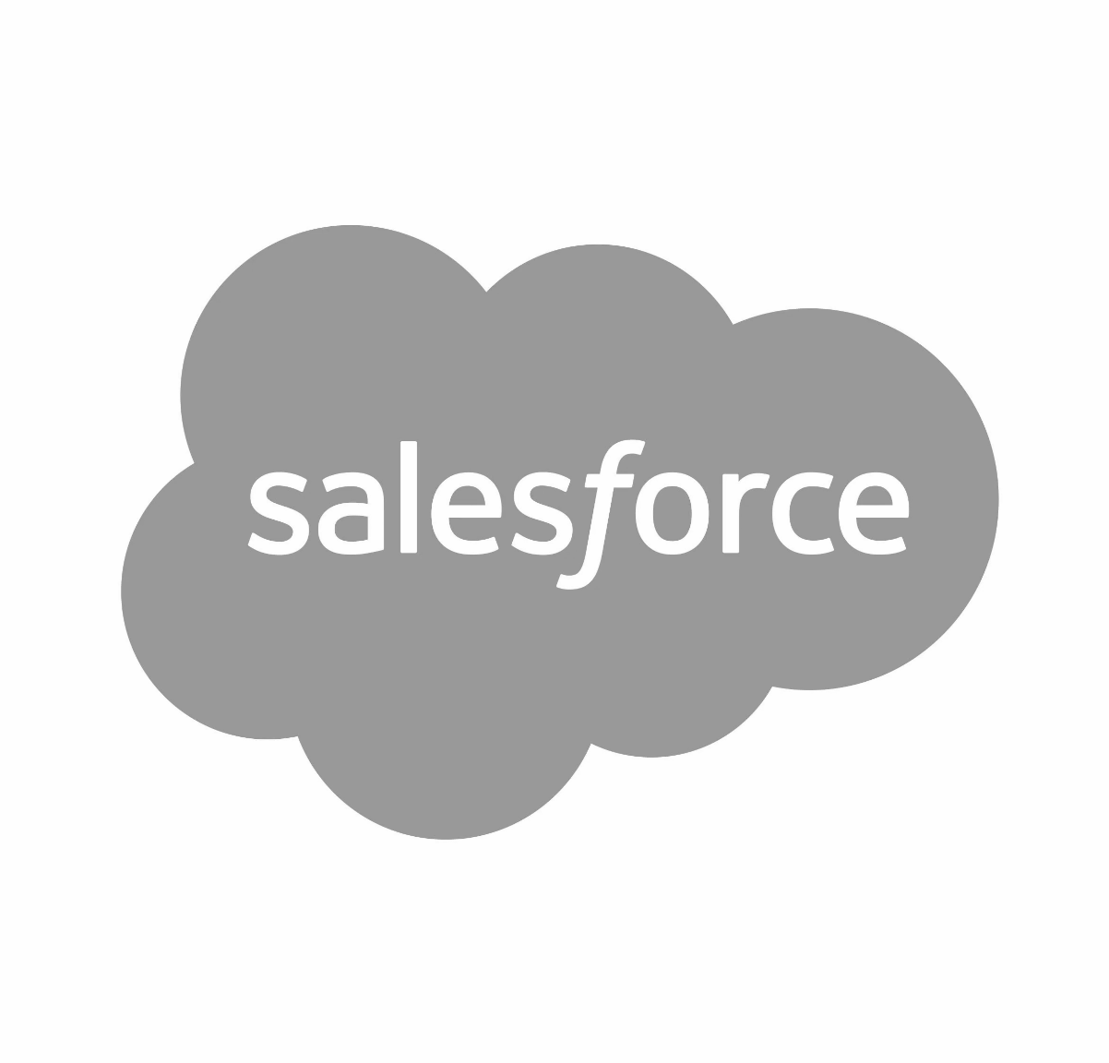



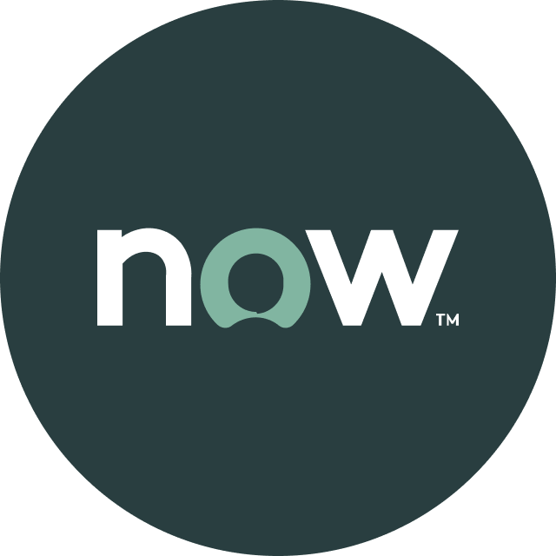


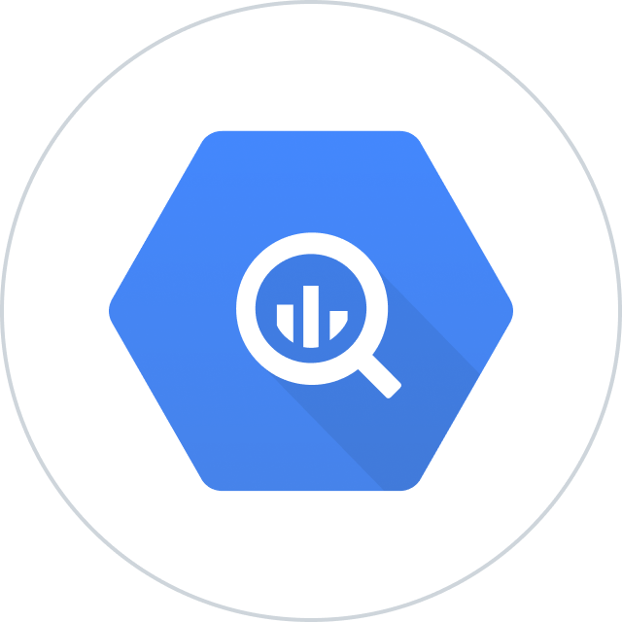


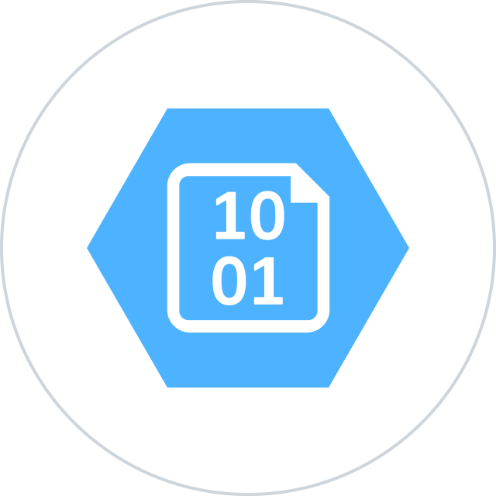


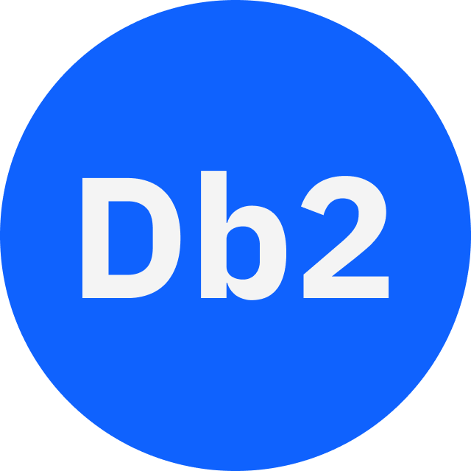




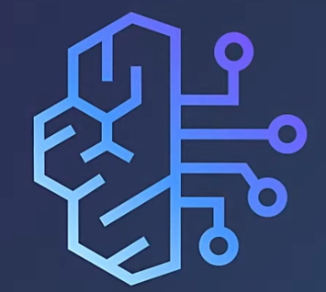
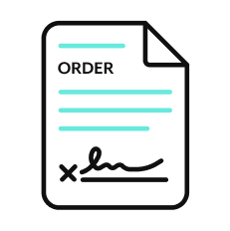







Orchestration for the Agentic Era—Powered by the #1 iPaaS.
I
Build agents with us
Go faster with Enterprise Skill packs and Workato Genies
W O R K A T O E N T E R P R I S E M C P
P L A T F O R M A G E N T S
E N T E R P R I S E S K I L L S
T R U S T
MCP Gateway
Observability
New simpler graphic
Solution Architect (AIRO™)
Skills Builder
MCP Composition
MCP Registry
MCP Proxy
Governance
O R C H E S T R A T I O N
Security
Data Scientist (Acumen)
Process Automation
Application Integration & B2B
Compliance
Data Orchestration
API Management
Explainability
Powered by iPaaS+
U N I V E R S A L C O N N E C T I V I T Y
SaaS/On-prem
Data Warehouse/ Data Lakes
Databases
LLMs
Unstructured
Traditional
Invoice
Media
Transcripts
Contracts
SFTP
Mainframe
Custom
Archives
Notes:
This is Workato ONE —Orchestration for the Agentic Era—Powered by the #1 iPaaS.
Unlike solutions that give you pieces of the puzzle, Workato ONE delivers the complete agentic enterprise:
Workato ONE One platform for data, apps, and agents
Workato GO puts enterprise search with Deep Action™ directly in every employee's hands
Workato Agentic builds and deploys production-ready agents with full enterprise context
Workato Enterprise MCP One trusted bridge for every agent to connect to applications and systems safely and securely
Workato Orchestrate powers complex workflows across teams, systems, and agents
All built on universal connectivity to 10,000+ applications and data sources
What makes this different? True Enterprise Orchestration.
Everyone talks about integration—APIs, MCP, basic workflows. But enterprise orchestration is fundamentally different. It's:
Transactionality that ensures every action completes or rolls back cleanly
In-sequence and exactly-once delivery so your financial transactions never duplicate
Runtime authentication and RBAC that enforces your security policies in real-time
PII obfuscation and data governance that maintains compliance automatically
Event-driven, batch, and real-time triggers that handle any integration pattern
Plus something no one else has: 1 million+ Enterprise Skills—pre-built, production-tested capabilities that encode your business logic, not just API calls. When an agent needs to "process a return," it doesn't just update a field—it orchestrates the entire business process across systems, with all the exception handling, approvals, and compliance checks your enterprise requires.
This unified approach enables true multi-agent orchestration. Your agents don't just connect—they inherit your enterprise's operational intelligence.

Slide 13

Thank you

Slide 14
Appendix of slides

Slide 15
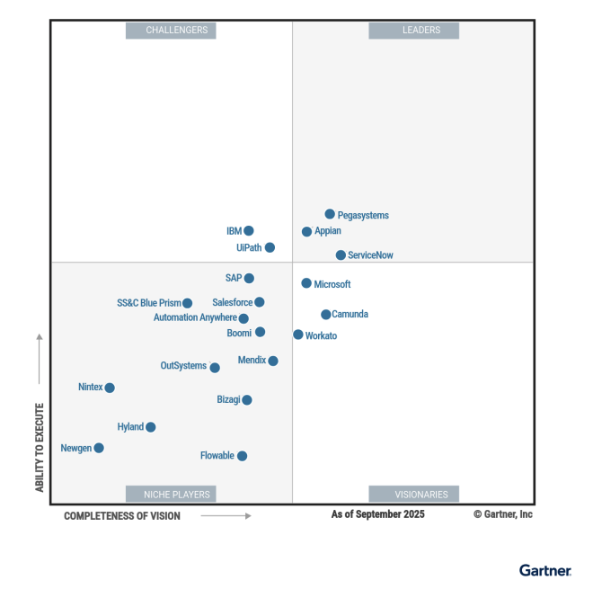
Leader in platforms and orchestration
Gartner iPaas : Leader - 7x
Visionary

